Slide 1
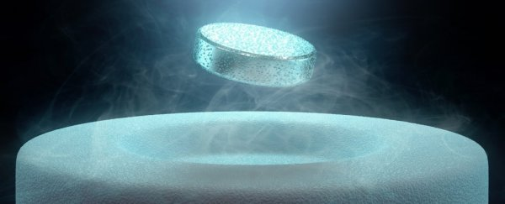


Synthesis of SFQ Circuits with Compound Gates
Download manuscript PDF
Rassul Bairamkulov, Alessandro Tempia Calvino, and Giovanni De Micheli
Integrated Systems Laboratory, EPFL, Switzerland
October 17, 2023
Notes:
Add names of authors

Slide 2

OUTLINE
Download manuscript PDF
Motivation
Rapid Single-Flux Quantum – Overview
Gate Compounding Technique
Technology Mapping
Results
Notes:
Remove

Slide 3
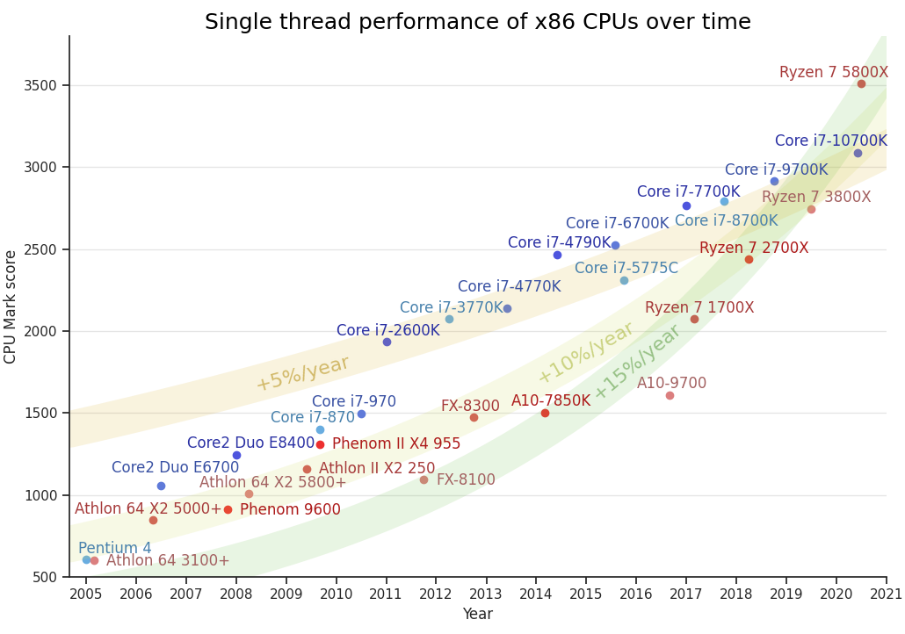
High-Performance Computing
Performance grows exponentially
+25% yearly
Most due to parallelization
Single-thread performance grows at a slower pace
+5-15% yearly
Many algorithms are poorly parallelized
Iterative optimization
Cryptography
Data compression
https://www.top500.org/statistics/perfdevel/
M. Lechner, “Evolution of Single-threaded x86 CPU Performance”, 2020
Notes:
Remove

Slide 4
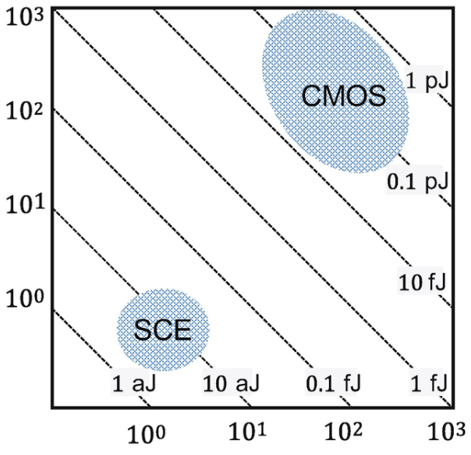
Rapid Single-Flux Quantum
Switching
power, µW
Invented in 1985 by K. Likharev and V. Semenov [1]
Superconductive technology
Cryogenic, 4.2 K
Based on SFQ pulses
Low-power
Hence low heat
Even considering refrigeration
World’s fastest digital technology
Record speed of 770 GHz [2]
Consistently achieving speeds above 10 GHz
Switching delay, ps
[1] K. K. Likharev and V. K. Semenov, RSFQ logic/memory family: a new Josephson-junction technology for sub-terahertz-clock-frequency digital systems, in IEEE TASC 1991
[2] W. Chen, et al. Rapid single flux quantum T-flip flop operating up to 770 GHz. IEEE TASC 1999.
[3] D. S. Holmes, et al. Energy-efficient superconducting computing—Power budgets and requirements. IEEE TASC 2013.
Notes:
mention pulse-based logic
mention that the plot is for single gate
Explain that presence/absence is 0/1
registers easy to do
inversion is hard
Explain gate compounding first
Traditionally - on safe side

Slide 5
RSFQ: Challenges
Fabrication technology
State of the art : 6k JJ/mm²
Compare to ~90M transistors/mm² (TSMC 7nm) [4]
Expensive memory
Poor density of inductor-based memory
Architectural differences
Gate-level pipelining
[4] E. Udin 2022, https://www.gizchina.com/2020/04/19/tsmc-3nm-details-announced-250-million-transistors-mm2-much-lower-power-consumption/

Slide 6
Path Balancing
Ensure correct order of signal arrival
Fundamental issue in superconductive electronics
A
B
C
D
E

Slide 7
Path Balancing
Ensure correct order of signal arrival
Fundamental issue in superconductive electronics
Dominates the IC area
A
B
C
D
E
Notes:
In general
clocking at every gate
needs sync input
I consider gate

Slide 8
OUTLINE
Motivation
Rapid Single-Flux Quantum – Overview
Gate Compounding Technique
Technology Mapping
Results

Slide 9

Josephson Junction (JJ)
V
Superconductor
Insulator
Superconductor
I₀
I₀
I_{c}
L
😴
I₀
I_{c}
Notes:
Illinois edu physics498 sqd

Slide 10

Josephson Junction (JJ)
V
I₀
I₀
I_{c}
L
😕
I₀
I_{c}
Notes:
Illinois edu physics498 sqd

Slide 11

Josephson Junction (JJ)
V
~1ps
I₀
~2mV
I_{c}
I₀
L
😲
I₀
I_{c}
Notes:
Static

Slide 12
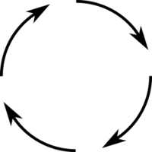
Basic JJ SQUID Loop
I₀
A
B
J₀
J₁
Logic 0
Notes:
Mention that it's called SQUID

Slide 13
Basic JJ Loop
I₀
A
B
J₀
J₁
Logic 0
Notes:
Combined current

Slide 14
Basic JJ Loop
I₀
A
B
J₀
J₁
Logic 1
Notes:
Mention that it's called SQUID

Slide 15
D flip-flop
CLK
I₀
J₂
D
Q
J₀
J₁
Logic 1
Notes:
Mention that it's called SQUID

Slide 16
D flip-flop
CLK
I₀
J₂
D
Q
J₀
J₁
Logic 1
Notes:
Mention that it's called SQUID

Slide 17
D flip-flop
CLK
I₀
J₂
D
Q
J₀
J₁
Logic 0
Notes:
Mention that it's called SQUID

Slide 18
D flip-flop
CLK
I₀
J₂
D
Q
J₀
J₁
Logic 0
Notes:
Mention that it's called SQUID

Slide 19
Inverter
CLK
I₀
A
Q
Notes:
Mention that it's called SQUID

Slide 20
Inverter
CLK
I₀
A
Q
Notes:
Mention that it's called SQUID

Slide 21
Inverter
CLK
I₀
A
Q
Notes:
Mention that it's called SQUID

Slide 22
Merger (Asynchronous OR)
A
I₀
Q
B
Notes:
Mention that it's called SQUID

Slide 23
Merger (Asynchronous OR)
A
I₀
Q
B
Notes:
Mention that it's called SQUID

Slide 24
AND Gate
A
I₀
Q
B
Notes:
Mention that it's called SQUID

Slide 25
AND Gate
A
I₀
Q
B
Notes:
A

Slide 26
AND Gate
A
I₀
Q
B
Notes:
B

Slide 27
AND Gate
A
I₀
CLK
Q
B
CLK
Notes:
B

Slide 28
OUTLINE
Motivation
Rapid Single-Flux Quantum – Overview
Gate Compounding Technique
Technology Mapping
Results

Slide 29
RSFQ Elements
Function
Behavior in RSFQ
RSFQ Symbol
NOT
XOR
AND
OR
OR*
M
Notes:
Mention that it's called SQUID

Slide 30
Three Types of SFQ Devices
Asynchronous
Asynchronous input
Asynchronous output
Synchronizers
Asynchronous input
Synchronized output
Synchronized
Synchronized input
Asynchronous output
AA
AS
SA
M
s

Slide 31
Gate Compounding Technique
AS right before SA
Synchronize inputs to SA gates
AA gates at periphery
Enrich functionality without extra cycles
AA
AS
SA
AA
M
M
s
s
[4] R. Bairamkulov and G. De Micheli, "Compound Logic Gates for Pipeline Depth Minimization in Single Flux Quantum Integrated Systems," Proc. GLSVLSI 2023
Notes:
DFF - introduce DFF
AND/OR - highlight the need for sync inputs

Slide 32
Gate Compounding: Example
SA gates sensitive to input timing
Place them after AS gates
Conventional RSFQ AND gate
AS
CLK
Q=AB
A
SA
I₀
Q
AS
CLK
B
Notes:
Move before

Slide 33
Gate Compounding: NIMPLY
Replace DFF with inverter
CLK
Q=AB
A
I₀
B
Q
CLK

Slide 34
Gate Compounding: XNOR
AS
AA
M
AA
A
s
M
B
s
A⊕B
SA

Slide 35
Case Study: 4-bit Brent Kung Adder
Gate compounding [4]
4 clock cycles
658 JJs
Conventional gates [5]
6 clock cycles
928 JJs
[4] R. Bairamkulov and G. De Micheli. "Compound Logic Gates for Pipeline Depth Minimization in Single Flux Quantum Integrated Systems." Proc. GLSVLSI 2023.
[5] T. Kawaguchi, K. Takagi, and N. Takagi. 2021. Rapid Single-Flux-Quantum Logic Circuits Using Clockless Gates. IEEE TASC Vol. 31, No. 4 2021.

Slide 36
OUTLINE
Motivation
Rapid Single-Flux Quantum – Overview
Gate Compounding Technique
Technology Mapping
Results

Slide 37
Technology Mapping 101
Convert logic function into gate-level netlist
Comply with technological constraints
Path balancing
Limited fanout
Timing constraints
Optimize target metrics
Area
Delay
Technology library
•••
Technology mapping
Gate-level
netlist
•••
Logic function
•••

Slide 38
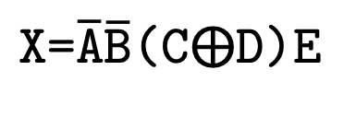
Technology Mapping 101
Convert logic function into gate-level netlist
Comply with technological constraints
Path balancing
Limited fanout
Timing constraints
Optimize target metrics
Area
Delay
$\text{X}\text{=}\overline{\text{A}}\overline{\text{B}}$($\text{C}⨁\text{D}$)E
A
B
C
D
X
E

Slide 39
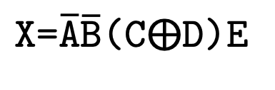
Technology Mapping 101
$\text{X}\text{=}\overline{\text{A}}\overline{\text{B}}$($\text{C}⨁\text{D}$)E
A
∧
B
∧
Convert logic function into gate-level netlist
Comply with technological constraints
Path balancing
Limited fanout
Timing constraints
Optimize target metrics
Area
Delay
C
∧
∧
X
∧
D
∧
E
A
B
C
D
X
E

Slide 40
Technology Mapping
A
∧
B
∧
Using technology library
Area and delay information
Convert technology-independent logic function,
Into technology-dependent network
Comply with technological constraints
Path balancing
Limited fanout
Timing constraints
Optimize target metrics
Area
Delay
C
∧
∧
X
∧
D
∧
E
A
x | y | z | f
0 | 0 | 0 | 0
0 | 0 | 1 | 1
0 | 1 | 0 | 0
0 | 1 | 1 | 1
1 | 0 | 0 | 0
1 | 0 | 1 | 1
1 | 1 | 0 | 1
1 | 1 | 1 | 1
A
Area=23
1 cycle
x | 1 | 0 | 1 | 0
y | 1 | 1 | 0 | 0
f | 1 | 0 | 0 | 0
B
x | y | f
0 | 0 | 0
0 | 1 | 1
1 | 0 | 1
1 | 1 | 0
B
C
Area=14
0 cycles
x | 1 | 0 | 1 | 0 | 1 | 0 | 1 | 0
y | 1 | 1 | 0 | 0 | 1 | 1 | 0 | 0
z | 1 | 1 | 1 | 1 | 0 | 0 | 0 | 0
f | 0 | 1 | 1 | 0 | 0 | 1 | 1 | 0
D
X
C
Area=11
1 cycle
x | 1 | 0 | 1 | 0
y | 1 | 1 | 0 | 0
f | 0 | 1 | 1 | 0
X
E
D
E
Notes:
Remove 37-38
Explain

Slide 41
Technology Mapping
A
∧
B
∧
Using technology library
Area and delay information
Convert technology-independent logic function,
Into technology-dependent network
Comply with technological constraints
Path balancing
Limited fanout
Timing constraints
Optimize target metrics
Area
Delay
C
∧
∧
X
∧
D
∧
E
A
x | y | z | f
0 | 0 | 0 | 0
0 | 0 | 1 | 1
0 | 1 | 0 | 0
0 | 1 | 1 | 1
1 | 0 | 0 | 0
1 | 0 | 1 | 1
1 | 1 | 0 | 1
1 | 1 | 1 | 1
A
Area=23
1 cycle
1 | 0 | 0 | 0
B
x | y | f
0 | 0 | 0
0 | 1 | 1
1 | 0 | 1
1 | 1 | 0
B
C
D
X
C
Area=11
1 cycle
0 | 1 | 1 | 0
Area=14
0 cycles
0 | 1 | 1 | 0 | 0 | 1 | 1 | 0
X
E
D
E

Slide 42
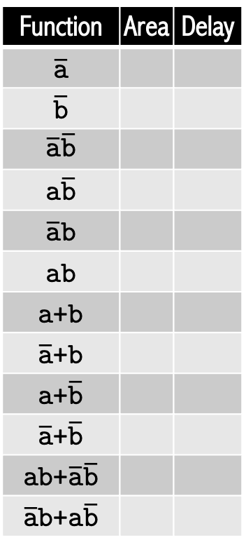
Precompute Technology Library
Function | Area | Delay
$$\overline{\text{a}}$$
$$\overline{\text{b}}$$
$$\overline{\text{a}}\overline{\text{b}}$$
$$\text{a}\overline{\text{b}}$$
$$\overline{\text{a}}\text{b}$$
$$\text{ab}$$
$\text{a}$+$\text{b}$
$\overline{\text{a}}$+$\text{b}$
$\text{a}$+$\overline{\text{b}}$
$$\overline{\text{a}}\text{+}\overline{\text{b}}$$
$\text{ab}$+$\overline{\text{a}}\overline{\text{b}}$
$\overline{\text{a}}\text{b}$+$\text{a}\overline{\text{b}}$
a [0]
b [0]
AA
AS
SA
AA
M
M
s
s
Notes:
Explain truth tables to represent functions
Don't use TT, use DNF sum of products

Slide 43
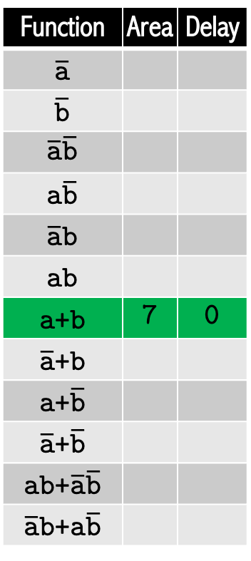
Precompute Technology Library: AA
Function | Area | Delay
$$\overline{\text{a}}$$
$$\overline{\text{b}}$$
$$\overline{\text{a}}\overline{\text{b}}$$
$$\text{a}\overline{\text{b}}$$
$$\overline{\text{a}}\text{b}$$
$$\text{ab}$$
$\text{a}$+$\text{b}$ | 7 | 0
$\overline{\text{a}}$+$\text{b}$
$\text{a}$+$\overline{\text{b}}$
$$\overline{\text{a}}\text{+}\overline{\text{b}}$$
$\text{ab}$+$\overline{\text{a}}\overline{\text{b}}$
$\overline{\text{a}}\text{b}$+$\text{a}\overline{\text{b}}$
Area=7
a [0]
M
a+b [7]
b [0]
AA
AS
SA
AA
M
M
s
s

Slide 44
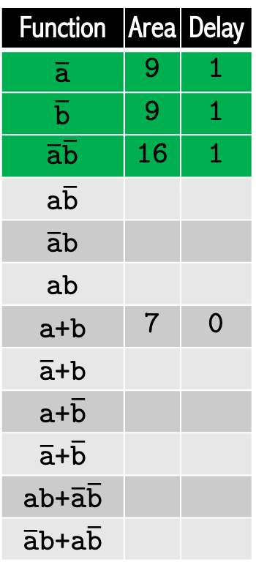
Precompute Technology Library: AS
Function | Area | Delay
$$\overline{\text{a}}$$ | 9 | 1
$$\overline{\text{b}}$$ | 9 | 1
$$\overline{\text{a}}\overline{\text{b}}$$ | 16 | 1
$$\text{a}\overline{\text{b}}$$
$$\overline{\text{a}}\text{b}$$
$$\text{ab}$$
$\text{a}$+$\text{b}$ | 7 | 0
$\overline{\text{a}}$+$\text{b}$
$\text{a}$+$\overline{\text{b}}$
$$\overline{\text{a}}\text{+}\overline{\text{b}}$$
$\text{ab}$+$\overline{\text{a}}\overline{\text{b}}$
$\overline{\text{a}}\text{b}$+$\text{a}\overline{\text{b}}$
Area=9
a [0]
b [0]
a+b [7]
AA
AS
SA
AA
M
M
s
s

Slide 45
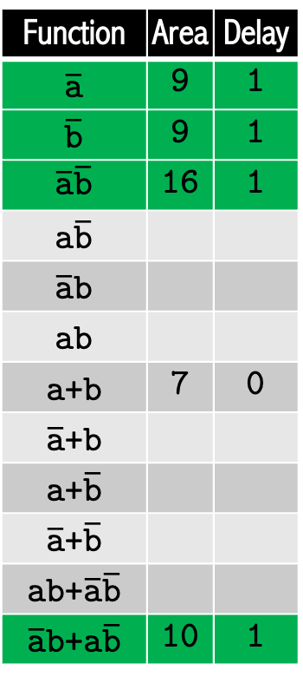
Precompute Technology Library: AS
Function | Area | Delay
$$\overline{\text{a}}$$ | 9 | 1
$$\overline{\text{b}}$$ | 9 | 1
$$\overline{\text{a}}\overline{\text{b}}$$ | 16 | 1
$$\text{a}\overline{\text{b}}$$
$$\overline{\text{a}}\text{b}$$
$$\text{ab}$$
$\text{a}$+$\text{b}$ | 7 | 0
$\overline{\text{a}}$+$\text{b}$
$\text{a}$+$\overline{\text{b}}$
$$\overline{\text{a}}\text{+}\overline{\text{b}}$$
$\text{ab}$+$\overline{\text{a}}\overline{\text{b}}$
$\overline{\text{a}}\text{b}$+$\text{a}\overline{\text{b}}$ | 10 | 1
Area=9
a [0]
b [0]
a+b [7]
AA
AS
SA
AA
Area=10
a [0]
M
M
b [0]
s
s

Slide 46
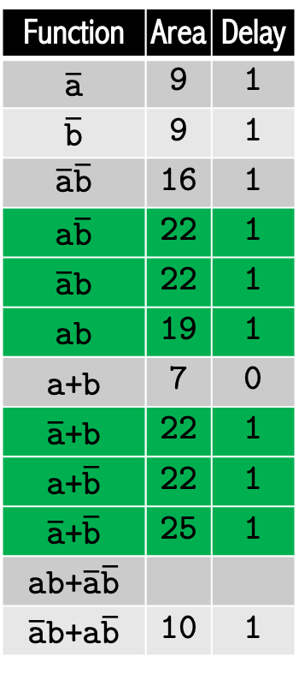
Precompute Technology Library: SA
Function | Area | Delay
$$\overline{\text{a}}$$ | 9 | 1
$$\overline{\text{b}}$$ | 9 | 1
$$\overline{\text{a}}\overline{\text{b}}$$ | 16 | 1
$$\text{a}\overline{\text{b}}$$ | 22 | 1
$$\overline{\text{a}}\text{b}$$ | 22 | 1
$$\text{ab}$$ | 19 | 1
$\text{a}$+$\text{b}$ | 7 | 0
$\overline{\text{a}}$+$\text{b}$ | 22 | 1
$\text{a}$+$\overline{\text{b}}$ | 22 | 1
$$\overline{\text{a}}\text{+}\overline{\text{b}}$$ | 25 | 1
$\text{ab}$+$\overline{\text{a}}\overline{\text{b}}$
$\overline{\text{a}}\text{b}$+$\text{a}\overline{\text{b}}$ | 10 | 1
Area=6
Area=7
a [0]
b [0]
ab [19]
Area=7
AA
AS
SA
AA
M
M
s
s
0010[17]
0100[17]

Slide 47
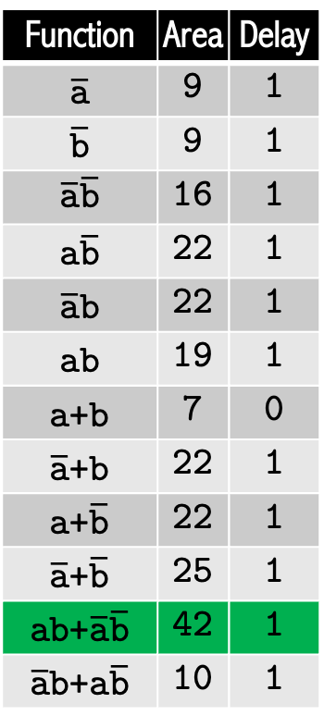
Precompute Technology Library: AA
Function | Area | Delay
$$\overline{\text{a}}$$ | 9 | 1
$$\overline{\text{b}}$$ | 9 | 1
$$\overline{\text{a}}\overline{\text{b}}$$ | 16 | 1
$$\text{a}\overline{\text{b}}$$ | 22 | 1
$$\overline{\text{a}}\text{b}$$ | 22 | 1
$$\text{ab}$$ | 19 | 1
$\text{a}$+$\text{b}$ | 7 | 0
$\overline{\text{a}}$+$\text{b}$ | 22 | 1
$\text{a}$+$\overline{\text{b}}$ | 22 | 1
$$\overline{\text{a}}\text{+}\overline{\text{b}}$$ | 25 | 1
$\text{ab}$+$\overline{\text{a}}\overline{\text{b}}$ | 42 | 1
$\overline{\text{a}}\text{b}$+$\text{a}\overline{\text{b}}$ | 10 | 1
Area=7
M
AA
AS
SA
AA
M
M
s
s
0010[17]
0100[17]

Slide 48
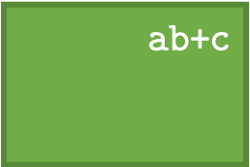

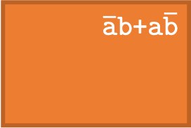
Technology Mapping
A
$$\overline{\text{a}}\overline{\text{b}}$$
A
∧
Area=23
1 cycle
1 | 0 | 0 | 0
B
$$\text{ab}\text{+}\text{c}$$
∧
B
C
$$\overline{\text{a}}\text{b}\text{+}\text{a}\overline{\text{b}}$$
∧
X
Precompute library of optimal structures
Only done once
Can be reused
Apply library to create gate-level netlist
∧
∧
C
Area=11
1 cycle
0 | 1 | 1 | 0
Area=14
0 cycles
0 | 1 | 1 | 0 | 0 | 1 | 1 | 0
X
D
∧
D
E
E
A
M
B
C
D
M
X
E
Notes:
We perform tech mapping
Boolean network with simple operations -> LUT mapping
(Simplify)
Apply enumeration to create library of optimal compound gates
Only once for
Apply library to create a gate netlist
(say)
Satisfy all sync requirements
Example on the right
Do not mention LUTs

Slide 49
Depth Reduction
A
Conventional RSFQ
10 elements
4 cycles
B
C
D
E
A
M
B
Gate compounding
6 elements
1 cycle
C
D
M
E

Slide 50
Results
Enumerated all 65,536 4-input functions
48x 2.5GHz Intel Xeon E5-2680 CPU
256GB of RAM
52 hour runtime
EPFL and ISCAS benchmarks
Mapped with mockturtle library [5]
On average vs state of the art [6]
24% smaller area
33% smaller depth
[5] https://github.com/lsils/mockturtle
[6] G. Pasandi and M. Pedram, "PBMap: A Path Balancing Technology Mapping Algorithm for Single Flux Quantum Logic Circuits," in IEEE TASC 2019
Notes:
Spend more time on AA AS SA
One slide for enumeration
show a compound gate
Remove #DFF section
Highlight reduction in table
Mention that we count all of the DFFs
Emphasize #JJs and delay

Slide 51
Summary
RSFQ can bring enormous improvements in power and speed
Gate compounding simplifies path balancing of RSFQ circuits
Smaller logic depth
More functionality in fewer clock cycles
Enumerate database of optimal small-scale structures up to 4 inputs
Apply to construct large scale networks
Smaller area and depth w.r.t. state-of-the-art
Notes:
Remove path balancing
Gate compounding - simplifying the balancing of circuits

Slide 52
Thank you!

